Slide 1
Counting Methods and Probability
Algebra 2
Chapter 10
Notes:
Algebra II 10

Slide 2
This Slideshow was developed to accompany the textbook
Larson Algebra 2
By Larson, R., Boswell, L., Kanold, T. D., & Stiff, L.
2011 Holt McDougal
Some examples and diagrams are taken from the textbook.
Slides created by
Richard Wright, Andrews Academy
rwright@andrews.edu

Slide 3
10.1 Apply the Counting Principle and Permutations
Let’s say you stop to get an ice cream sundae
You pick one each of
Flavors: vanilla, chocolate, or strawberry
Syrups: fudge or caramel
Toppings: nuts or sprinkles
How many different sundaes can you choose?

Slide 4
10.1 Apply the Counting Principle and Permutations
Sundaes
Vanilla
Fudge
Caramel
Fudge
Strawberry
Caramel
Fudge
Caramel
Nuts
Sprinkles
Nuts
Sprinkles
Chocolate
Nuts
Sprinkles
Nuts
Sprinkles
Nuts
Sprinkles
Nuts
Sprinkles
Each sundae can have 3 flavors
Each flavor can have 2 syrups
Each syrup can have 2 toppings
3·2·2 = 12 sundaes

Slide 5
10.1 Apply the Counting Principle and Permutations
Fundamental Counting Principle
If there are multiple events, multiply the number of ways each event happens to get the total number of ways all the events can happen.

Slide 6
10.1 Apply the Counting Principle and Permutations
A restaurant offers 8 entrees, 2 salads, 12 drinks, and 6 desserts. How many meals if you choose 1 of each?
How many different 7 digit phone numbers if the first digit cannot be 0 or 1?
Notes:
(8)(2)(12)(6) = 1152
(8)(10)(10)(10)(10)(10)(10) = 8,000,000

Slide 7
10.1 Apply the Counting Principle and Permutations
Permutation
How many ways to order objects
A, B, C →
ABC, ACB, BAC, BCA, CAB, CBA → 6 ways
Number of Permutations of n objects taken r at a time
$${{}_{n}^{}P}_{r}=\frac{n!}{\left(n−r\right)!}$$
Factorial (!) – that number times all whole numbers less than it
$5!=5⋅4⋅3⋅2⋅1=120$

Slide 8
10.1 Apply the Counting Principle and Permutations
You have 5 different homework assignments.
How many different orders can you complete them all?
How many different orders can you complete the first two?
Notes:
₅P₅ = 5!/0! = 120
₅P₂ = 5!/3! = 20

Slide 9
10.1 Apply the Counting Principle and Permutations
There are 12 books to read over summer.
How many orders to read 4 of them?
How many orders to read all 12 books?
Notes:
₁₂P₄ = 12!/8! = 11880
₁₂P₁₂ = 12!/0! = 479001600

Slide 10
10.1 Apply the Counting Principle and Permutations
Permutations with Repetition
$$\frac{n!}{q_{1}!⋅q_{2}!⋅q_{3}!⋯}$$
Where n is the number of objects and q is how many times each is repeated.
How many ways to rearrange WATERFALL?
Notes:
9!/(2!2!) = 90720

Slide 11
Quiz
10.1 Homework Quiz

Slide 12
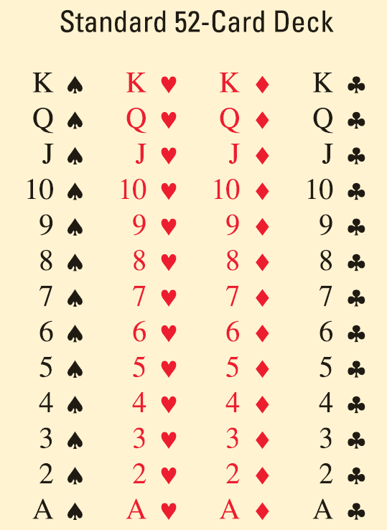
10.2 Use Combinations and Binomial Theorem
Combination
Arranging of objects without order
$${{}_{n}^{}C}_{r}=\frac{n!}{\left(n−r\right)!r!}$$
Using a standard 52-card deck
How many 7-card hands?
How many 7-card flushes?
Notes:
₅₂C₇ = 52!/(45!7!) = 133784560
₄C₁ * ₁₃C₇ = 6864

Slide 13
10.2 Use Combinations and Binomial Theorem
On vacation you can visit up to 5 cities and 7 attractions.
How many combinations of 3 cities and 4 attractions?
How many combinations to visit at least 8 locations?
Notes:
₅C₃ * ₇C₄ = 350
₁₂C₈ + ₁₂C₉ + ₁₂C₁₀ + ₁₂C₁₁ + ₁₂C₁₂ = 794

Slide 14
10.2 Use Combinations and Binomial Theorem
A restaurant offers 6 salad toppings. On a deluxe salad, you can have up to 4 toppings. How many combinations?
Notes:
Each of the 6 are either yes or no – the 5 and 6 choices
2⁶ – (₆C₅ + ₆C₆) = 57

Slide 15
10.2 Use Combinations and Binomial Theorem
Binomial Theorem
(x + y)⁰ 1
(x + y)¹ 1x 1y
(x + y)² 1x² 2xy 1y²
(x + y)³ 1x³ 3x²y 3xy² 1y³
(x + y)⁴ 1x⁴ 4x³y 6x²y² 4xy³ 1y⁴
Notes:
Pascal’s triangle
Rows are n
Diagonals are r
Each number on the triangle is _{n}C_{r}

Slide 16
10.2 Use Combinations and Binomial Theorem
Binomial Theorem
(a+b)^{n} = _{n}C₀a^{n-0}b⁰ + _{n}C₁a^{n-1}b¹ + … + _{n}C_{r}a^{n-r}b^{r}
$$=\sum_{r=0}^{n}{{{}_{n}^{}C}_{r}a^{n−r}b^{r}}$$

Slide 17
10.2 Use Combinations and Binomial Theorem
Expand (a + 3)⁵
Notes:
₅C₀a⁵3⁰ + ₅C₁a⁴3¹ + ₅C₂a³3² + ₅C₃a²3³ + ₅C₄a¹3⁴ + ₅C₅a⁰3⁵
1a⁵1 + 5a⁴3 + 10a³9 + 10a²27 + 5a¹81 + 1*1*243
a⁵ + 15a⁴ + 90a³ + 270a² + 405a + 243

Slide 18
10.2 Use Combinations and Binomial Theorem
Expand (x + 2y³)⁴
Notes:
₄C₀x⁴(2y³)⁰ + ₄C₁x³(2y³)¹ + ₄C₂x²(2y³)² + ₄C₃x¹(2y³)³ + ₄C₄x⁰(2y³)⁴
1x⁴1 + 4x³(2y³) + 6x²(4y⁶) + 4x(8y⁹) + 1*1(16y¹²)
x⁴ + 8x³y³ + 24x²y⁶ + 32xy⁹ + 16y¹²

Slide 19
10.2 Use Combinations and Binomial Theorem
Find the coefficient of the x⁷ term in
(2 – 3x)¹⁰
Notes:
n = 10, r = 7
₁₀C₇a³b⁷ = 120(2)³(-3x)⁷ → -2099520x⁷

Slide 20
Quiz
10.2 Homework Quiz

Slide 21
10.3 Define and Use Probability
Probability
A number between 0 and 1 to indicate how likely something is to happen
0 = cannot happen
1 = always happens
Theoretical Probability
$$P\left(A\right)=\frac{\text{Number} \text{of} \text{ways} \text{A} \text{happens}}{\text{Total} \text{number} \text{of} \text{possible} \text{outcomes}}$$

Slide 22
10.3 Define and Use Probability
A spinner with 8 equal sections are numbered 1 to 8. Find
P(6) ■ P(n > 5)
There are 9 students on a team. Names are drawn to determine order of play. What is the probability that 3 of the 5 seniors will be chosen last?
Notes:
P(6) = 1/8
P(n>5) = 3/8
(₅C₃)/₉C₃ = .119

Slide 23
10.3 Define and Use Probability
Experimental Probability
Found by performing an experiment or survey
Geometric Probability
Probabilities found from picking random points from areas or lines

Slide 24
10.3 Define and Use Probability
Find the probability that a random dart will hit the shaded area.
4
Notes:
Circles: d = 4 → r = 2
Rectangle: l = 4, w = 8
Area rectangle = 4(8) = 32
Area circle = π(2)² → 4π
Area shaded = 32 – 2(4π) = 32 - 8π
P(shaded) = shaded/whole thing = (32-8π)/32 = .215

Slide 25
10.3 Define and Use Probability
Odds
When all outcomes are equally likely, the odds in favor of an event A is
$$\text{Odds} \text{in} \text{favor} \text{of} \text{A}=\frac{\text{Number} \text{of} \text{outcomes} \text{in} \text{A}}{\text{Number} \text{of} \text{outcomes} \text{not} \text{in} \text{A}}$$
You can write odds as a ratio $\frac{a}{b}$ or $a:b$

Slide 26
10.3 Define and Use Probability
A card is randomly drawn from a standard deck. Find the indicated odds.
In favor of drawing a heart
Against drawing a queen
Notes:
13/39 = 1/3
48/4 = 12/1

Slide 27
Quiz
10.3 Homework Quiz

Slide 28
10.4 Find Probability of Disjoint and Overlapping Events (OR)
Let’s say you have 1 event and you want one of two results to happen
This is a compound event
There may be some intersections where one condition satisfies both events so the events are overlapping
If there is no intersection, then they are disjoint or mutually exclusive

Slide 29
10.4 Find Probability of Disjoint and Overlapping Events (OR)
P(A or B) = P(A) + P(B) – P(A and B)
If they are disjoint or mutually exclusive
P(A and B) = 0
A
B
Notes:
The overlap (A and B) is counted twice (once with A and once with B) so it is subtracted once.

Slide 30
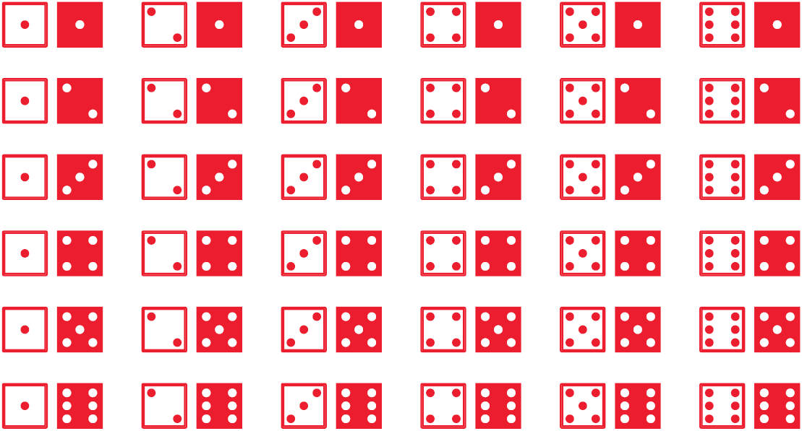
10.4 Find Probability of Disjoint and Overlapping Events (OR)
One D6 is rolled. What is the probability of rolling a multiple of 3 or 5?
Two D6 are rolled. What is the probability of rolling a sum that is a multiple of 2 or 3?
Notes:
D6 means six-sided-dice
P(mult 3 or 5) = P(mult 3) + P(mult 5) – P(mult 3 and 5)
P(mult 3 or 5) = 2/6 + 1/6 – 0 = 3/6 = ½
P(mult 2 or 3) = P(mult 2) + P(mult 3) – P(mult 2 and 3)
P(mult 2 or 3) = 3/6 + 2/6 – 1/6 = 4/6 = 2/3

Slide 31
10.4 Find Probability of Disjoint and Overlapping Events (OR)
In a poll of high school Jrs., 6 out of 15 took French and 11 out of 15 took math. 14 out of 15 took French or math. What is the probability that a student took both French and math?
Notes:
P(F or M) = P(F) + P(M) – P(F and M)
14/15 = 6/15 + 11/15 – P(F and M)
P(F and M) = 3/15 = 1/5

Slide 32
10.4 Find Probability of Disjoint and Overlapping Events (OR)
Complements ($\overline{\text{A}}$)
All the outcomes not in A
P($\overline{\text{A}}$) = 1 – P(A)
A card is randomly selected from a standard 52-card deck. Find
P(not K)
P(not (A or red))
Notes:
P(not K) = 1 – P(K) = 1 – 4/52 = 48/52 = 12/13
P(not A or red) = 1 – P(A or red) = 1 – (P(A) + P(red) – P(A and red)) = 1 – (4/52 + 26/52 – 2/52) = 1-28/52 = 1-7/13=6/13

Slide 33
Quiz
10.4 Homework Quiz

Slide 34
10.5 Find Probabilities of Independent and Dependent Events (AND)
Independent events
1 event has no effect on another event
P(A and B) = P(A)·P(B)

Slide 35
10.5 Find Probabilities of Independent and Dependent Events (AND)
A game machine claims that 1 in every 15 wins. What is the probability that you win twice in a row?
In a survey 9 out of 11 men and 4 out of 7 women said they were satisfied with a brand of orange juice. If the next 3 customers are 2 women and 1 man, what is the probability that all will be satisfied?
Notes:
P(W)P(W) = (1/15)(1/15) = 1/225 = .0044444
P(W)P(W)P(M) = (4/7)(4/7)(9/11) = 144/539 = .267

Slide 36
10.5 Find Probabilities of Independent and Dependent Events (AND)
An auto repair company finds that 1 in 100 cars have to be returned for the same reason. If you take your car in 10 times, what is the probability that you will have the same thing fixed at least once.
Notes:
At least once means 1 time + 2 times + 3 times + 4 times + …
P(at least once) = 1 – P(0 10 times)¹⁰ = 1 - 0.99¹⁰ = 0.096

Slide 37
10.5 Find Probabilities of Independent and Dependent Events (AND)
Dependent Events
Dependent – 1 event affects the next
Conditional Probability P(B|A)
Probability that B occurs given that A already occurred
P(A and B) = P(A)·P(B|A)

Slide 38
10.5 Find Probabilities of Independent and Dependent Events (AND)
You randomly draw 2 cards from a standard 52-card deck. Find the probability that the 1st card is a diamond and the 2nd is red if:
You replace
You don’t replace
Notes:
P(◊)P(R) = (13/52)(26/52) = 1/8 = .125
P(◊)P(R|◊) = (13/52)(25/51) = .1225

Slide 39
10.5 Find Probabilities of Independent and Dependent Events (AND)
Three children have a choice of 12 summer camps. If they choose randomly, what is the probability that they choose different camps (it is possible to choose the same camp)?
Notes:
P(A and B and C)
P(A)P(B|A)P(C|A and B)
1(11/12)(10/12) = 110/144 = .764

Slide 40
10.5 Find Probabilities of Independent and Dependent Events (AND)
In a town, 95% of students graduate HS. A study shows that at age 25, 81% of HS grads held full-time jobs while only 63% of those who did not graduate held full-time jobs. What is the probability that a randomly selected student will have a full-time job?
Notes:
P(FT) = P(Grad and FT) + P(nonGrad and FT)
= P(Grad)P(FT|Grad) + P(nonGrad)P(FT|nonGrad)
= (.95)(.81) + (.05)(.63)
= .801

Slide 41
Quiz
10.5 Homework Quiz

Slide 42
10.6 Construct and Interpret Binomial Distributions
Construct Probability Distributions
Make a table of all possible values of X and P(X)
Use that data to draw a bar graph (histogram)
A tetrahedral die has four sides numbered 1 through 4. Let X be a random variable that represents the sum when two such dice are rolled.
Notes:
(1st die, 2nd die)
Possible outcomes
(1, 1) (2, 1) (3, 1) (4, 1)
(1, 2) (2, 2) (3, 2) (4, 2)
(1, 3) (2, 3) (3, 3) (4, 3)
(1, 4) (2, 4) (3, 4) (4, 4)
X 2 3 4 5 6 7 8
P(X) 1/16 2/16 3/16 4/16 3/16 2/16 1/16

Slide 43
10.6 Construct and Interpret Binomial Distributions
Binomial Distributions
Two outcomes: Success or failure
Independent trials (n)
Probability for success is the same for each trial (p)
P(k successes) = _{n}C_{k} p^{k} (1-p)^{n-k}

Slide 44
10.6 Construct and Interpret Binomial Distributions
At college, 53% of students receive financial aid. In a random group of 9 students, what is the probability that exactly 5 of them receive financial aid?
Notes:
p = .53, n = 9, k = 5
P(5) = ₉C₅(.53)⁵(1-.53)⁹⁻⁵ = .257

Slide 45
10.6 Construct and Interpret Binomial Distributions
Draw a histogram of binomial distribution of students in example 1 and find the probability of fewer than 3 students receiving financial aid.
Notes:
P(0) = ₉C₀(.53)⁰(1-.53)⁹⁻⁰ = .00112
P(1) = ₉C₁(.53)¹(1-.53)⁹⁻¹ = .01136
P(2) = .05123
P(3) = .13480
P(4) = .22801
P(5) = .25712
P(6) = .19330
P(7) = .09342
P(8) = .02634
P(9) = .00330
P(<3) = P(0) + P(1) + P(2) = .00112 + .01136 + .05123 = .06371

Slide 46
Quiz
10.6 Homework Quiz

